Slide 1

Lead Scoring Case Study using Logistic Regression
Group 9
Mayur Rane
Raviteja Reddy
Devika Ramakrishna
Swati Patke
Santhosh Rajasingaram

Slide 2
Logistic Regression: An Overview
An overview of logistic regression, a statistical technique used to model the probability of a certain outcome based on one or more predictor variables.
Logistic Regression is a supervised classification model.
It allows you to make predictions from labelled data, if the target (output) variable is categorical.

Slide 3
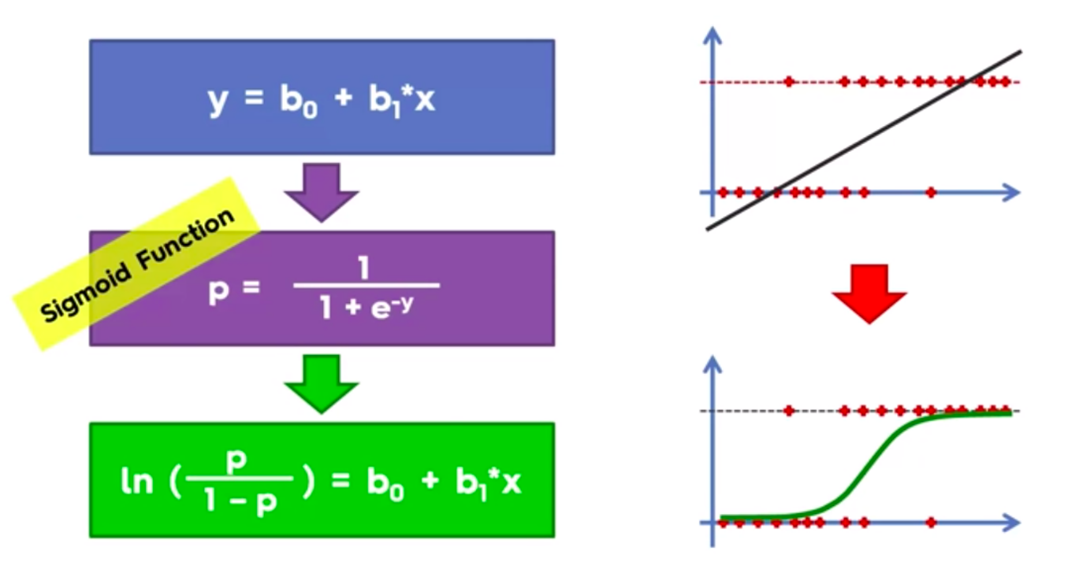
Logistic Regression vs. Linear Regression
Logistic regression used to model the probability of a certain outcome based on predictor variables
Linear regression used to model the relationship between a continuous outcome variable and predictor variables

Slide 4
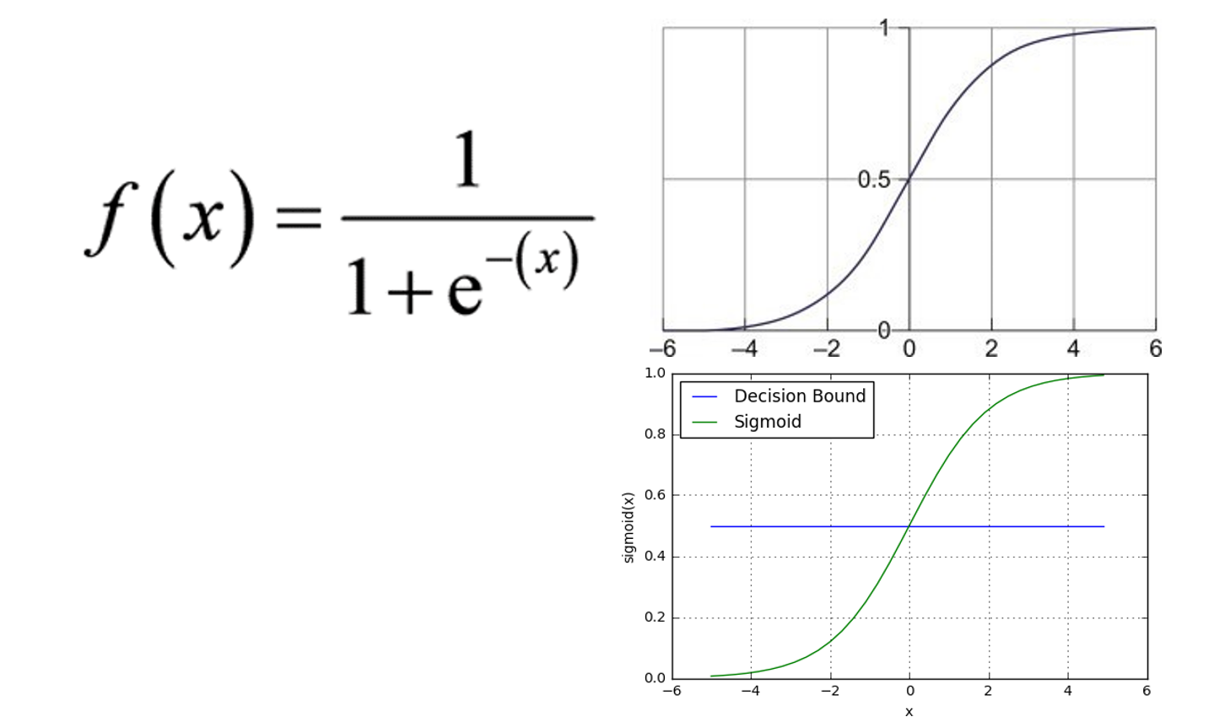
The Logistic Function and Model Estimation
The logistic function, or sigmoid function, is used to model the probability of the outcome variable
The logistic regression model estimates coefficients of predictor variables that maximize the likelihood of the observed data.

Slide 5
Assumptions of Logistic Regression
The relationship between predictor variables and the outcome variable is linear
Observations are independent of each other
No multicollinearity among predictor variables

Slide 6

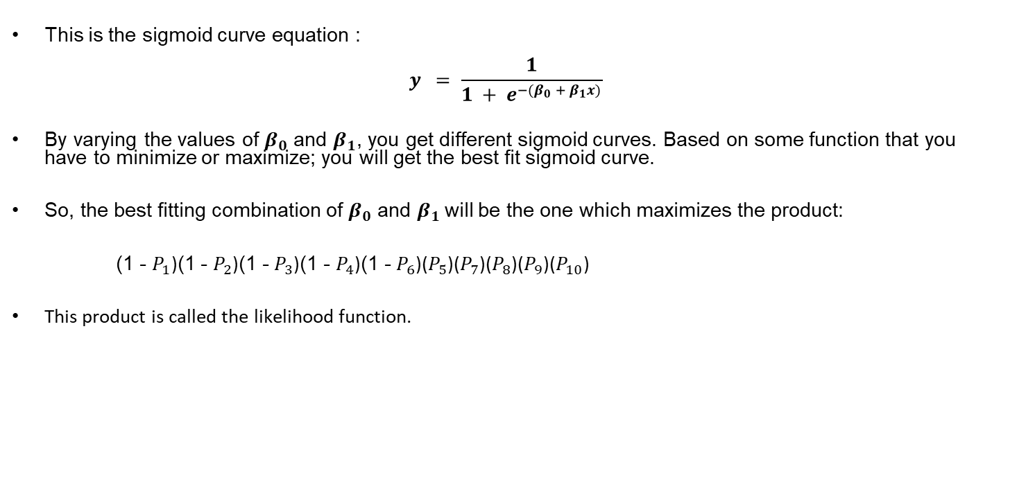
Logistic Regression
Concept of Maximum Likelihood Function
This is the sigmoid curve equation :
$$y = \frac{1}{1 + e^{−(β_{0} + β_{1}x)}}$$
By varying the values of $β_{0}$ and $β_{1}$, you get different sigmoid curves. Based on some function that you have to minimize or maximize; you will get the best fit sigmoid curve.
So, the best fitting combination of $β_{0}$ and $β_{1}$will be the one which maximizes the product:
(1 - $P_{1}$)(1 - $P_{2}$)(1 - $P_{3}$)(1 - $P_{4}$)(1 - $P_{6}$)($P_{5}$)($P_{7}$)($P_{8}$)($P_{9}$)($P_{10}$)
This product is called the likelihood function.

Slide 7
Problem Statement
X Education offers online courses to industry professionals. The company markets its courses on several websites and search engines like Google.
X Education gets a lot of leads, its lead conversion rate is very poor.
To improve the efficiency of this process, the organization aims to identify the most promising prospects, commonly known as "Hot Leads”.

Slide 8
Business Goals
Identify the most promising leads such that customers with higher lead score have a higher conversion chance.
Build an analytical model that can estimate the lead score for the new customer-based learning from the past data.
Enhance the usability of the model to reduce the number of unnecessary follow ups and use the human resources efficiently.

Slide 9
METHODOLOGY FOR MODEL PREPARATION
Data Cleaning, imputing and understanding the data variables
To check null values and ‘Select’ and to find a solution to combat such values
To check outliers in the data
Exploratory data Analysis
Creation of Dummy variables for categorical variables
Scaling of numerical variables
Logistic Regression Model
Model evaluation using confusion matrix, precision, recall, specificity

Slide 10
Brief about our data and Cleaning/Imputation
Total columns at initial = 37
Columns such as ‘City’, ‘Country’, ’Prospect Id’, ’Lead number’ are eliminated as there serve no enhancement in analysis
Eliminating all the ‘Asymmetric’ like features as these contain more than 50% of null values
Reducing the data by removing all the rows which contain the ‘Select’ values in columns such as ‘Specialization’
Imbalance Ratio (convert_0/convert_1) = 0.96

Slide 11
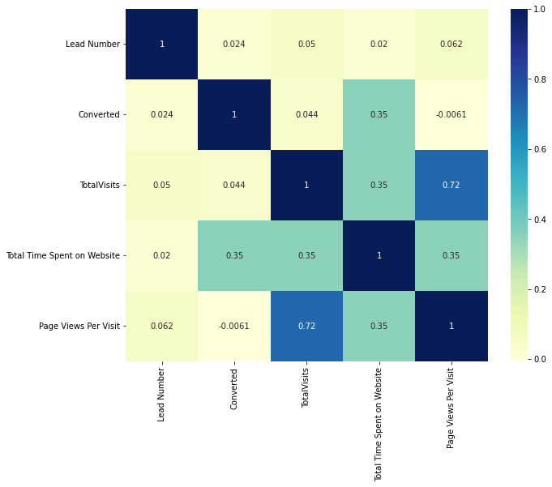
Let’s look at some independent variables: Correlation Matrix
1) Total visits & Page views per visit column are correlated.
2) To avoid multi-collinearity, we should have either of these columns in our model

Slide 12
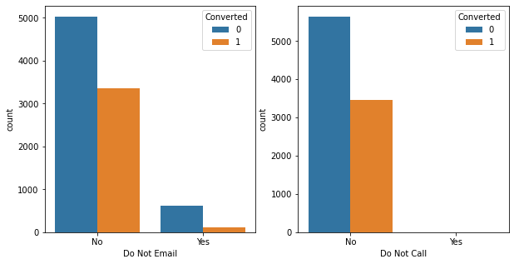
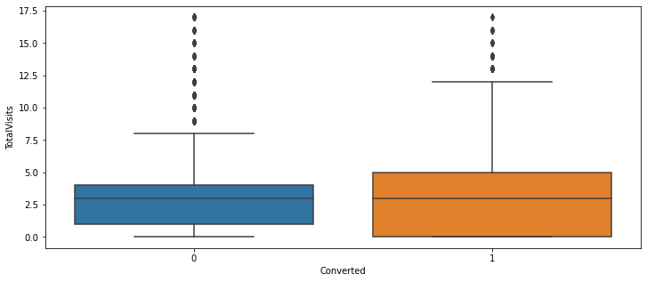
Do Not Email & Do Not Call
Almost 99% of customers do not like to be called or receive emails about the course
Total Visits
The median for converted and non-converted leads are same
People who visit the website have equal chances (50-50) of applying and not applying for the course

Slide 13
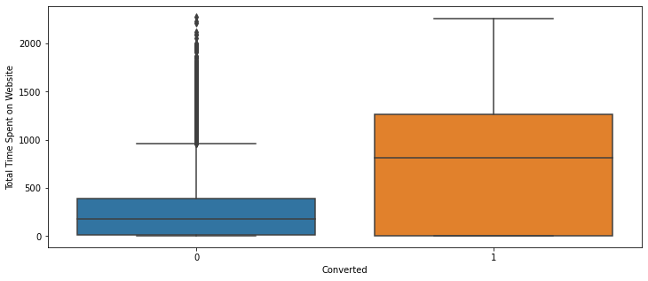
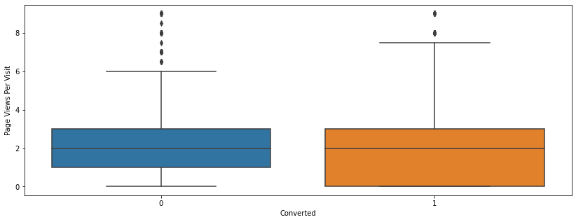
Total Time Spent on Website
People spending more time on website have more chances of enrolling for / selecting a course
People who spend less time on the website didn't opt for any courses
Page Views per Visit
Median for converted and unconverted leads is the same
Nothing can be said specifically for lead conversion from Page Views Per Visit

Slide 14
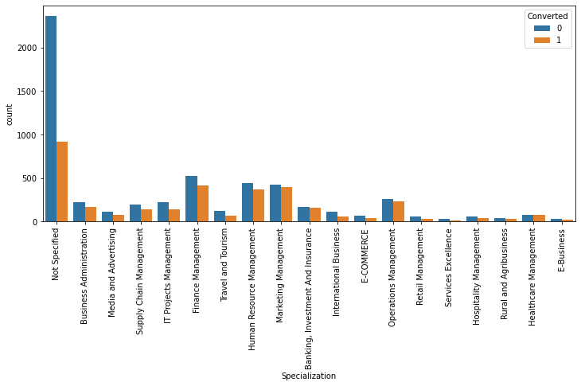
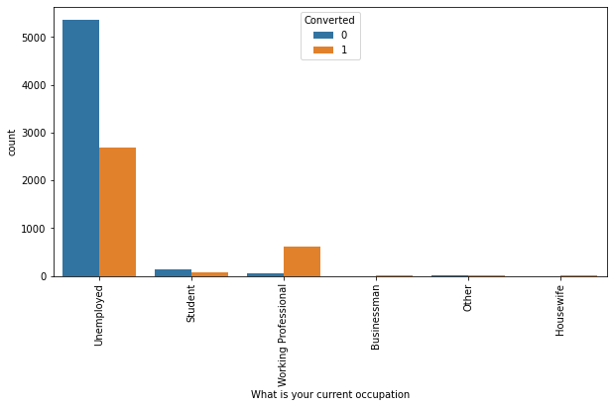
Specialization
Most of the specializations have around 45-50% conversion rate
Occupation
Working Professionals and Unemployed people generate maximum leads
Conversion rate for Working Professionals is very high and for Unemployed is also around 40%

Slide 15
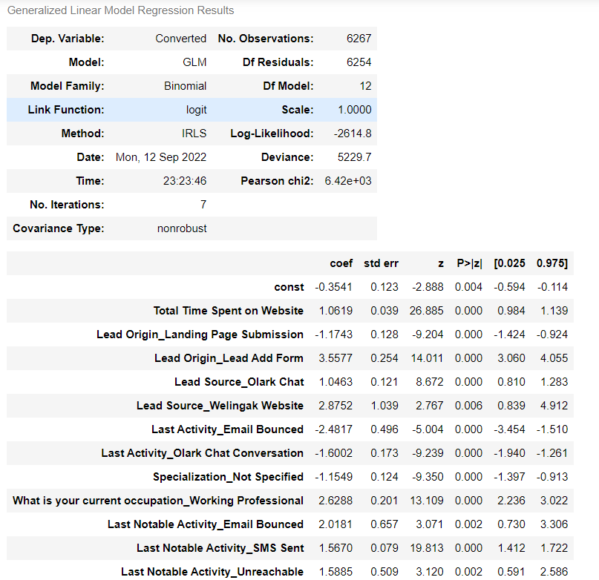
Final Model Summary

Slide 16
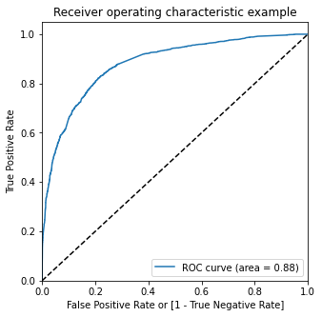
ROC Curve
The ROC (Receiver Operating Characteristic) curve is a graphical representation used to evaluate the performance of a binary classifier, such as logistic regression, in terms of its sensitivity (true positive rate) and specificity (1 - false positive rate) across various decision thresholds.

Slide 17
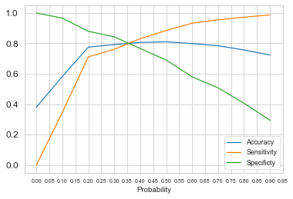
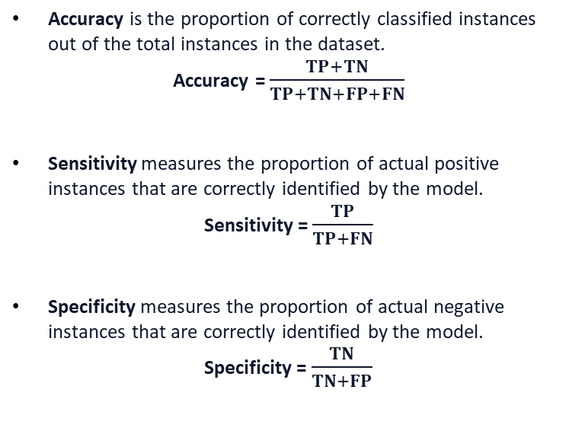
Accuracy, Sensitivity & Specificity
Accuracy is the proportion of correctly classified instances out of the total instances in the dataset.
Accuracy = $\frac{TP+TN}{TP+TN+FP+FN}$
Sensitivity measures the proportion of actual positive instances that are correctly identified by the model.
Sensitivity = $\frac{TP}{TP+FN}$
Specificity measures the proportion of actual negative instances that are correctly identified by the model.
Specificity = $\frac{TN}{TN+FP}$

Slide 18
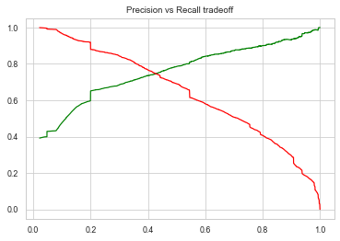
Metrics – Precision & Recall

Slide 19
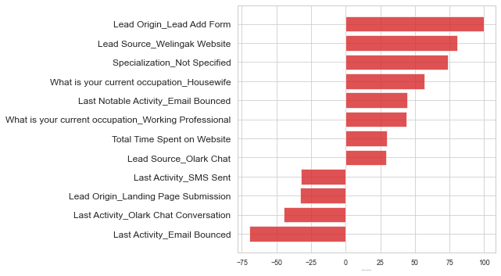
Feature Importance
Identifying the most important features helps in predicting the outcome variable and improve model performance.

Slide 20
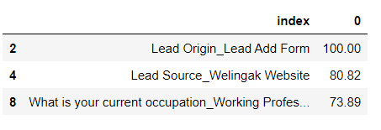
Top 3 Features

Slide 21
Recommendations
1) The sales team of the X-Education company should focus on the leads having “Lead origin - lead add form”, “Occupation - Working Professional”, and “Lead source - Wellingak website”
2) Sales Team of the company should focus more on Hot Leads (who are identified as customers having lead score greater than 35
3) Other important variables like city, specialization, and occupation can potentially explain Conversion better. Hence, it is mandatory to make the customers provide this information,
4) We have a high recall score compared to the precision score. Hence this model has the ability to adjust to the company’s requirements in the coming future

Slide 22
Thank you for your time and attention 🙂

